Slide 1
Activity Lifecycle & Runtime Permissions

Slide 2

How Do You Use Mobile Apps?
Are mobile apps essentially desktop apps adapted for smaller screens?
What is the typical lifespan of a mobile app, and how does it compare to desktop applications?
While waiting for a train at the station, how can you maximise the use of your mobile device?
When using a specific app, how does your experience get affected by interruptions, such as phone calls, and how easily can you resume your previous tasks?
In the Android, how is the activation and coordination of multiple apps managed?
All the activation and juggling of these apps are managed by Android runtime
Notes:
Mobile apps aren’t really desktop apps running on a smaller screen.
We don’t use mobile apps the way we use desktop apps.
When we use a desktop app, it usually stays open and active for quite some time because we are focused on the task at hand.
Mobile apps have a shorter life span.
We usually take it out of the pocket, do something quick, and then put it back.
Sometimes even, when we are using a particular app, we might get interrupted by another app (e.g., a phone call), so the original app we were looking at would be hidden by the interrupting app.
All the activation and juggling of these apps are managed by the Android runtime.

Slide 3

Who is in control of the app lifecycle?
User vs Developers
Notes:
As a developer, you are not in control of the lifecycle of your app; the user is

Slide 4
Android Runtime (ART)
Android Runtime (ART) is an application runtime environment used by the Android operating system
You cannot assume that the user will not be interrupted in the middle of inputting data to your app
You also cannot assume that your app will always exit gracefully; it could get killed without getting the chance to properly shut down
As a developer, you need to be defensive in designing your code and consider that these things can happen
Fortunately, the Android runtime notifies us whenever something happens to our components (like the activity)

Slide 5
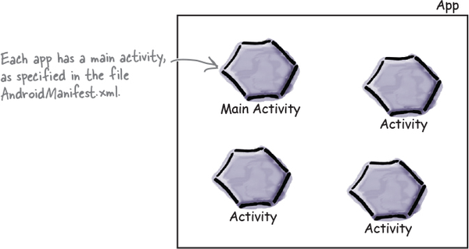
Remember
An app is a collection of activities, layouts, and other resources
One of these activities is the main activity for the app

Slide 6
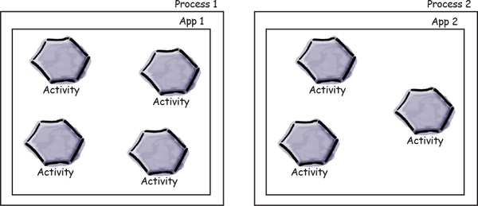
App Process
By default, each app runs within its own process
This helps keep your app safe and secure
You can read more about Android Runtime here

Slide 7
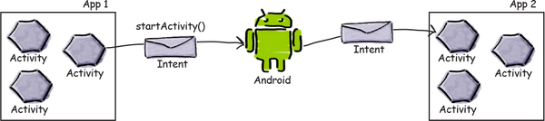
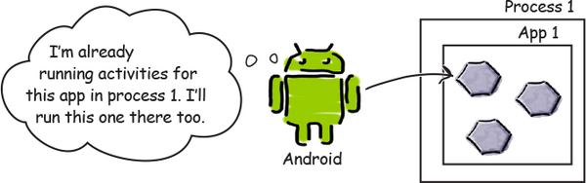
How Android Manage Process
Your app can start an activity in another application by passing an intent with startActivity()
The Android system knows about all the device’s installed apps and their activities use the intent to start the correct activity
When an activity needs to start, Android checks whether there’s already a process for that app
If one exists, Android runs the activity in that process
If one doesn’t exist, Android creates one

Slide 8

onCreate() Method
When Android starts an activity, it calls its onCreate() method
onCreate() is always run whenever an activity gets created

Slide 9

How Activities Function?
We need to find answers to these questions:
How long does an activity live for?
What happens when your activity disappears from the screen? Is it still running? Is it still in memory?
What happens if your app gets interrupted by an incoming phone call?
We want to be able to control the behavior of our activities in a whole range of different circumstances, but how?
To do so, we need to know the activity lifecycle events in Android!

Slide 10
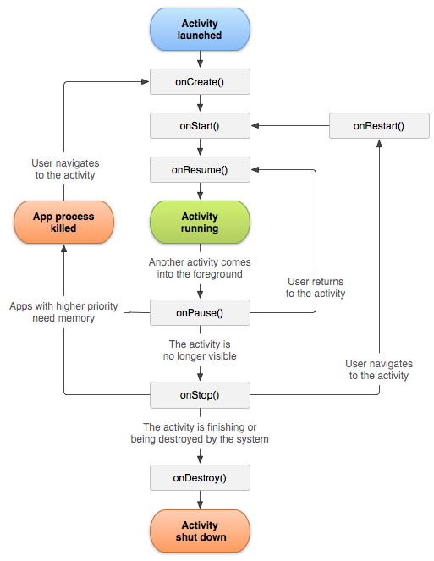
Activity lifecycle events
public class Activity extends ApplicationContext {
protected void onCreate(Bundle savedInstanceState);
protected void onStart();
protected void onRestart();
protected void onResume();
protected void onPause();
protected void onStop();
protected void onDestroy();
}

Slide 11
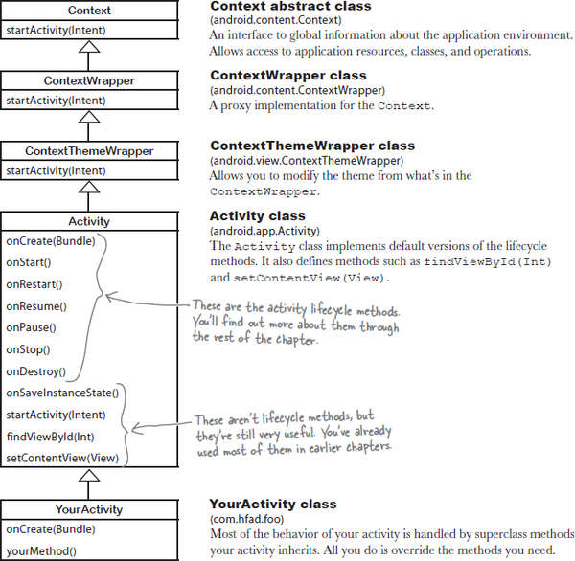
android.app.Activity class
Your activity extends the android.app.Activity class
This class gives your activity access to the Android lifecycle methods

Slide 12
Callback Methods
Method | Description | Killable? | Next
onCreate() | Called when the activity is first created. This is where you should do all of your normal static set up: create views, bind data to lists, etc. This method also provides you with a Bundle containing the activity's previously frozen state, if there was one. | No | onStart()

Slide 13
Callback Methods
Method | Description | Killable? | Next
onRestart() | Called after your activity has been stopped, prior to it being started again. | No | onStart()

Slide 14
Callback Methods
Method | Description | Killable? | Next
onStart() | Called when the activity is becoming visible to the user. Followed by onResume() if the activity comes to the foreground, or onStop() if it becomes hidden. | No | onResume() or onStop()

Slide 15
Callback Methods
Method | Description | Killable? | Next
onResume() | Called when the activity will start interacting with the user. At this point your activity is at the top of its activity stack, with user input going to it. | No | onPause()

Slide 16
Callback Methods
Method | Description | Killable? | Next
onPause() | Called when the activity loses foreground state, is no longer focusable or before transition to stopped/hidden or destroyed state. The activity is still visible to user, so it's recommended to keep it visually active and continue updating the UI. Implementations of this method must be very quick because the next activity will not be resumed until this method returns. Followed by either onResume() if the activity returns back to the front, or onStop() if it becomes invisible to the user. | Pre-Build.VERSION_CODES.HONEYCOMB | onResume() or onStop()

Slide 17
Callback Methods
Method | Description | Killable? | Next
onStop() | Called when the activity is no longer visible to the user. This may happen either because a new activity is being started on top, an existing one is being brought in front of this one, or this one is being destroyed. This is typically used to stop animations and refreshing the UI, etc. Followed by either onRestart() if this activity is coming back to interact with the user, or onDestroy() if this activity is going away. | Yes | onRestart() or onDestroy()

Slide 18
Callback Methods
Method | Description | Killable? | Next
onDestroy() | The final call you receive before your activity is destroyed. This can happen either because the activity is finishing (someone called Activity#finish on it), or because the system is temporarily destroying this instance of the activity to save space. | Yes | nothing

Slide 19

Entire Lifetime
The entire lifetime of an activity happens between the first call to onCreate(Bundle) through to a single final call to onDestroy()
An activity will do all setup of "global" state in onCreate() and release all remaining resources in onDestroy()
For example, if it has a process/thread running in the background to download data from the network, it may create that process/thread in onCreate() and then stop the thread in onDestroy()

Slide 20
Visible Lifetime
The visible lifetime of an activity happens between a call to onStart() until a corresponding call to onStop()
During this time the user can see the activity on-screen, though it may not be in the foreground and interacting with the user
Between these two methods you can maintain resources that are needed to show the activity to the user
The onStart() and onStop() methods can be called multiple times, as the activity becomes visible and hidden to the user

Slide 21
Foreground Lifetime
The foreground lifetime of an activity happens between a call to onResume() until a corresponding call to onPause()
During this time the activity is visible, active and interacting with the user
An activity can frequently go between the resumed and paused states -- for example when the device goes to sleep, when an activity result is delivered, when a new intent is delivered -- so the code in these methods should be fairly lightweight

Slide 22
Visible & Foreground lifetime
Foreground lifetime
Visible lifetime

Slide 23
Permissions
The purpose of a permission is to protect the privacy of an Android user
Android apps must request permission to access sensitive user data (such as contacts and SMS), as well as certain system features (such as camera and internet)
Depending on the feature, the system might grant the permission automatically or might prompt the user to approve the request

Slide 24
Android Security Architecture
A central design point of the Android security architecture is that no app, by default, has permission to perform any operations that would adversely impact other apps, the operating system, or the user
This includes reading or writing the user's private data (such as contacts or emails), reading or writing another app's files, performing network access, keeping the device awake, and so on

Slide 25
Permission Approval
<manifest xmlns:android="http://schemas.android.com/apk/res/android" package="com.example.snazzyapp"> <uses-permission android:name="android.permission.SEND_SMS"/> <application ...> ... </application> </manifest>

Slide 26
Protection Levels
Permissions are divided into several protection levels affects whether runtime permission requests are required
There are three protection levels that affect third-party apps: normal, signature, and dangerous permissions

Slide 27
Normal Permissions
Normal permissions cover areas where your app needs to access data or resources outside the app's sandbox (process), but where there's very little risk to the user's privacy or the operation of other apps. For example, permission to set the time zone is a normal permission
If an app declares in its manifest that it needs a normal permission, the system automatically grants the app that permission at install time
The system doesn't prompt the user to grant normal permissions, and users cannot revoke these permissions

Slide 28
Signature Permissions
The system grants these app permissions at install time, but only when the app that attempts to use a permission is signed by the same certificate as the app that defines the permission

Slide 29
Dangerous Permissions/Runtime Permissions
Dangerous permissions cover areas where the app wants data or resources that involve the user's private information or could potentially affect the user's stored data or the operation of other apps
For example, the ability to read the user's contacts is a dangerous permission
If an app declares that it needs a dangerous permission, the user has to explicitly grant the permission to the app
Until the user approves the permission, your app cannot provide functionality that depends on that permission

Slide 30
Request Prompts for Dangerous Permissions
Only dangerous permissions require user agreement
The way Android asks the user to grant dangerous permissions depends on the version of Android running on the user's device, and the system version targeted by your app
Read through the below resources and discuss the best practices
App permissions best practices
Permissions on Android

Slide 31
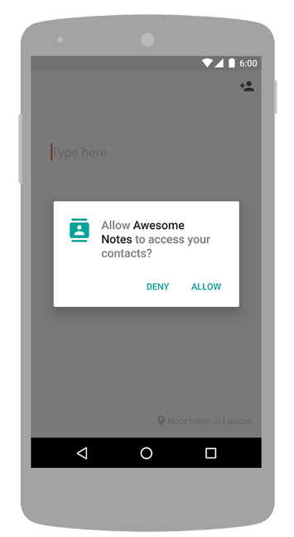
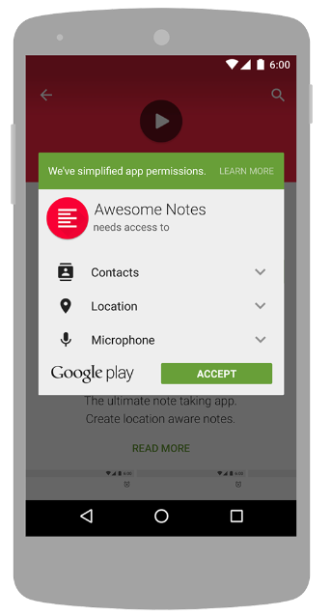
Runtime requests Install-time requests Android 6.0 (API level 23) or higher Android 5.1.1 (API level 22) or lower

Slide 32
Resources:
Android developer website

